Slide 1
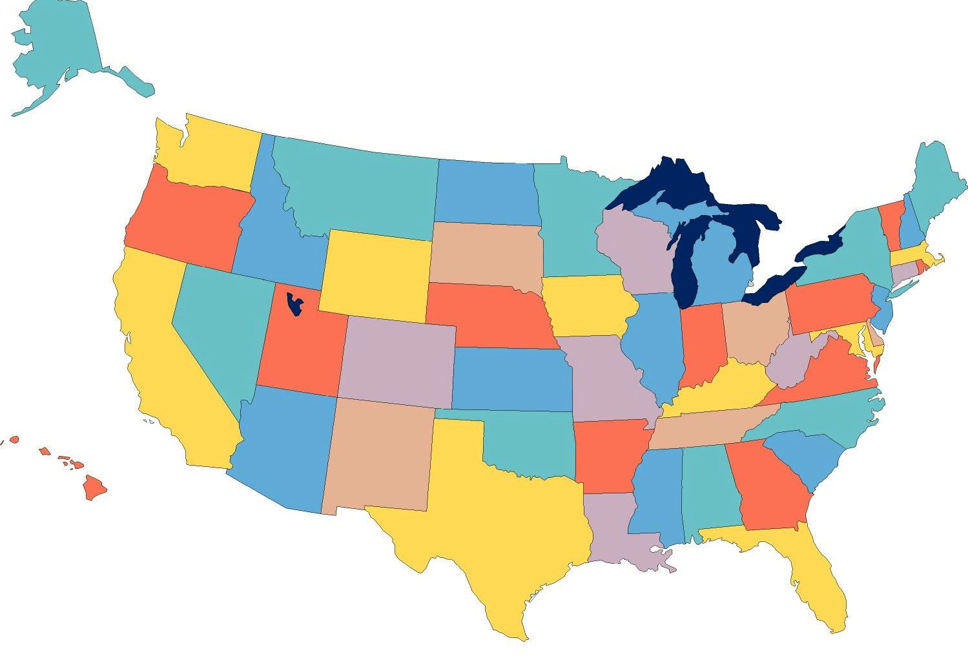





State of the Union for Employment First
David Hoff
Institute for Community Inclusion
University of Massachusetts, Boston
National Board President
APSE

Slide 2



David Hoff
617-287-4308
david.hoff@umb.edu
www.communityinclusion.org
david@apse.org
www.apse.org

Slide 3


“Any darn fool can make something complicated;
it takes genius to achieve simplicity.”
- Woody Guthrie

Slide 4

Employment First: What Is It?
General theme:
Employment in the community is the first/primary service option for individuals with disabilities
APSE Statement on Employment First
Employment in the general workforce is the first and preferred outcome in the provision of publicly funded services for all working age citizens with disabilities, regardless of level of disability.

Slide 5

Clear state policy:
Employment as first priority
Broadly focused on ALL aspects of system: funding, data, quality assurance, polices and procedures, training/staff development, procurement, service providers, etc.
May begin in grassroots, but ultimately must be adopted and implemented by the system
Not focused on eliminating facility-based services

Slide 6



Why Employment First is Important
Sets a clear direction from a
policy and practice perspective

Slide 7


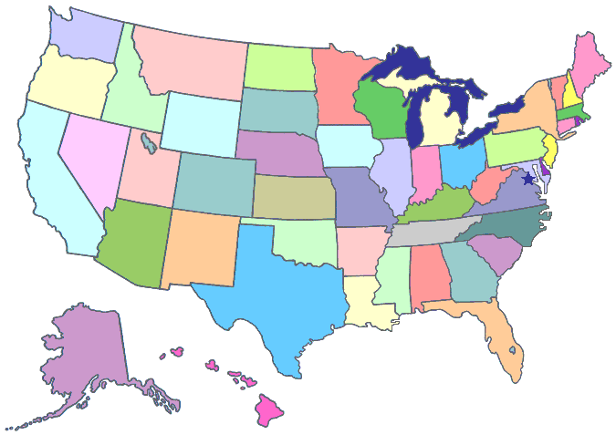
Employment First:
Why It’s
Important
Promoting a national conversation on employment
Is spurring a national movement
Spreading across the country

Slide 8


Employment First
2013
35+ states have some type of “Employment First” movement
  About 2/3 of efforts are directed by state policy units or are legislatively based
  About 1/3 of efforts are grassroots based – i.e., outsiders working to influence state policy and practice
At least 24 states have official Employment First legislation and/or polices
Push for a Federal Definition

Slide 9

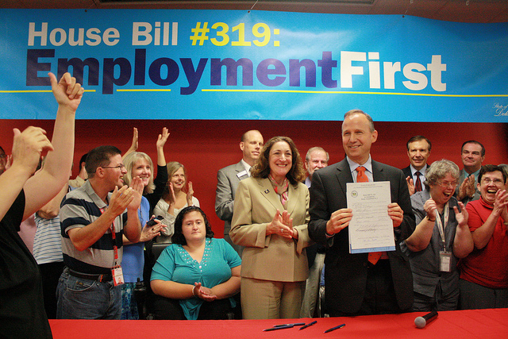
Employment First Policies:
A Closer Look
24 States with a policy:
AR, CA, CO, CT, DE, IL, KS, LA, MD, MA, ME, MI, MO, ND, NJ, OH, OK, OR, PA, RI, TN, UT, VA, WA
9 have passed legislation (CA, DE, IL, KS, ND, PA, VA, UT, WA)
Remainder are Executive Orders, policy directives, etc.
9 state polices are cross-disability; remainder ID/DD

Slide 10


It’s A Time of Enormous Opportunity

Slide 11


National Governor’s Association Initiative

Slide 12


Senate HELP Committee Report
Increase employment of people with disabilities by
over 1 million by 2015

Slide 13


CMS Guidance
Highlights and provides guidance for implementation of CMS’s goal to promote integrated employment options through the Medicaid waiver program

Slide 14
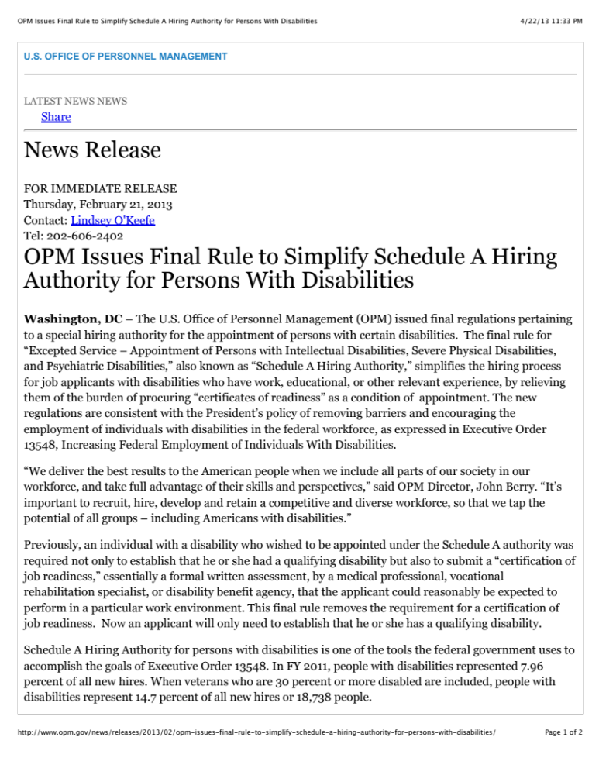
Federal Hiring
Increased efforts by federal government to hire people with disabilities under “Schedule A”. February 2013 rules have eliminated need for certification of “job readiness”.

Slide 15


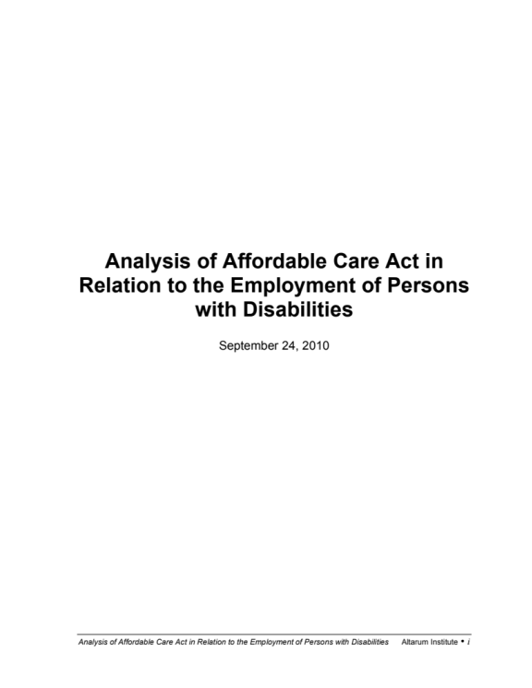
Expanded Health Care Options under the Affordable Care Act

Slide 16
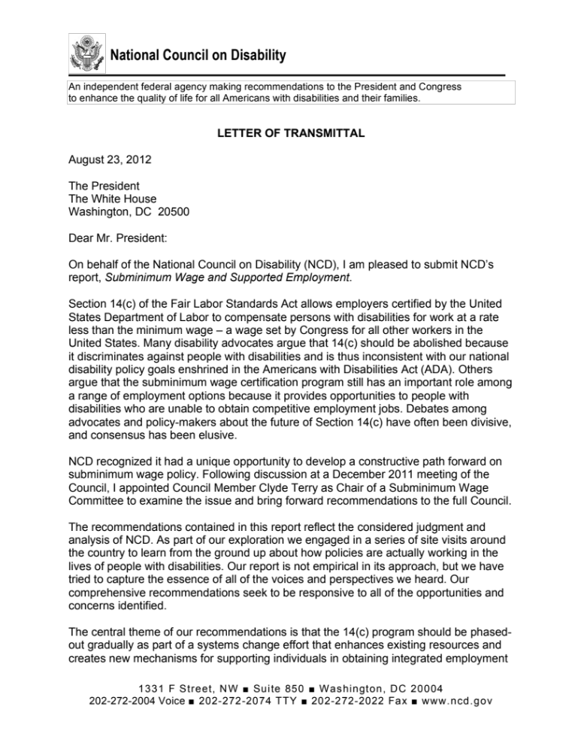
National Council on Disability Report
Federal Agency calling for phase out sub-minimum wage as part of overall systems change
Make fundamental changes in transition

Slide 17
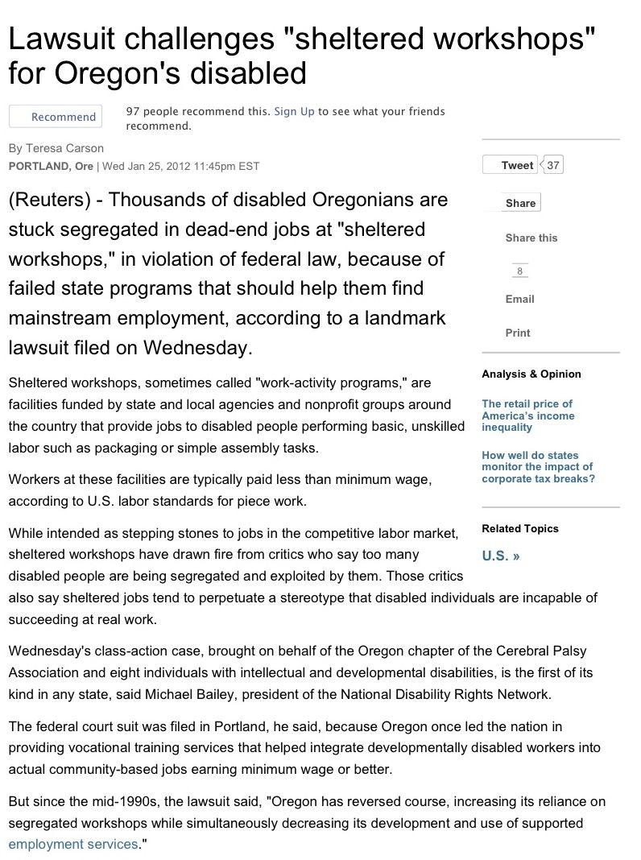

Oregon Lawsuit
Claims placement in sheltered workshop is violation of ADA
US Dept. of Justice is now a plaintiff in this suit

Slide 18

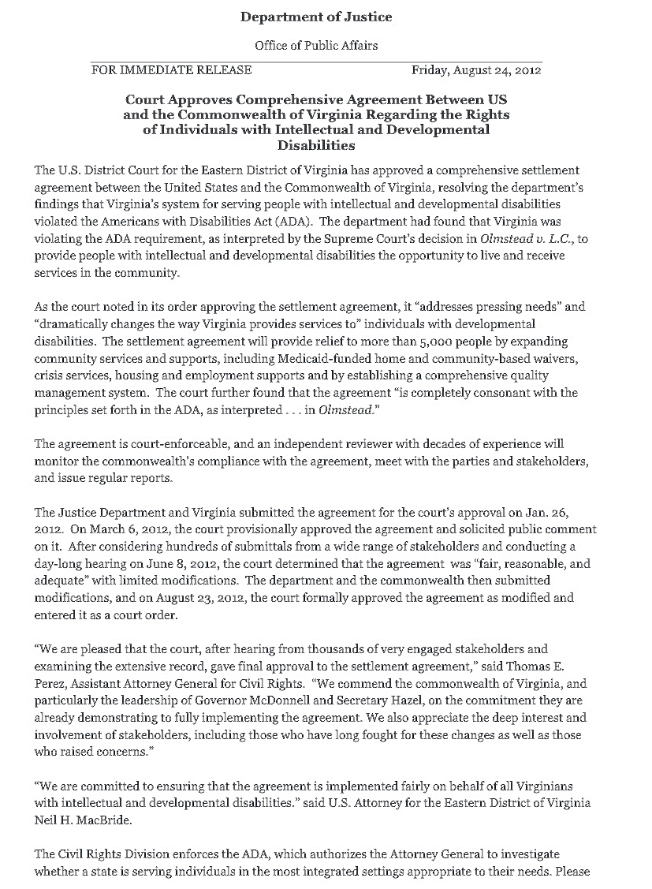
Requirements for expanding community employment increasingly part of settlement agreements with states

Slide 19


It’s A Time of Enormous
Challenge

Slide 20


Increasing scrutiny of services and outcomes

Slide 21


Growing Social Security Disability Roles (SSI & SSDI)
Congressional Research Service: SSDI Trust Fund will Run Out in 2016

Slide 22

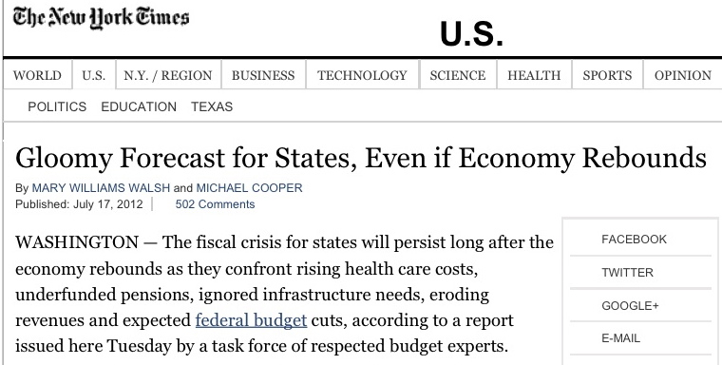
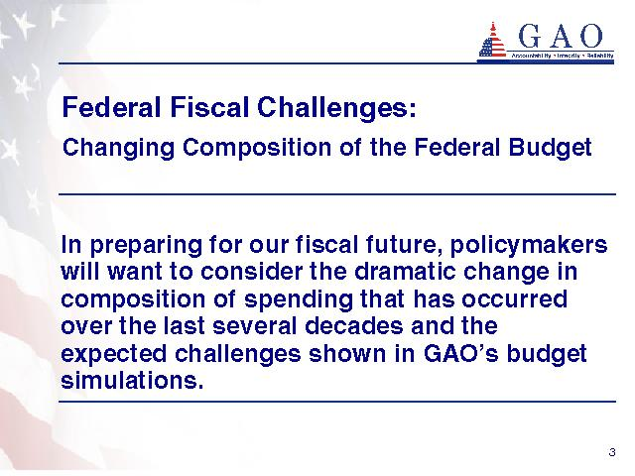

Short and Long-Term Fiscal Challenges at State & Federal Level

Slide 23



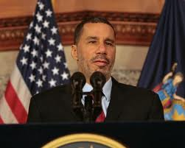
Despite efforts over the past two decades, employment participation of people with disabilities remains stagnant.

Slide 24




Slide 25
US Census
 | PA | National
Percent of individuals 18-64 with disability | 14% | 10%
Disability Employment Rate | 32% | 33%
Non-Disability Employment Rate | 72% | 73%
Living in Poverty | 17% | 14%
Service System Data
 | PA | National
ODP – % in Integrated Employment Services | 15% | 19%
Mental Health– % Employed | 4% | 20%
VR– Rehabilitation Rate | 51% | 54%
Workforce dev.– % of customers with disabilities | 4% | 3%

Slide 26


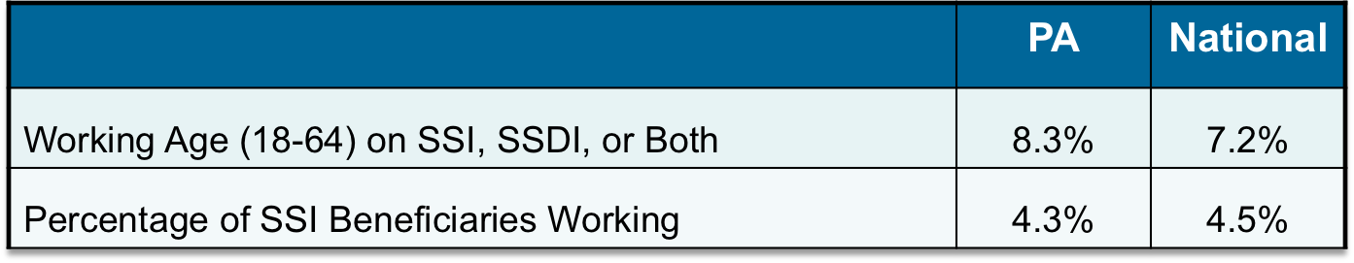
Social Security Disability Insurance & Supplemental Security Income
– Source: Social Security Administration, 2011

Slide 27


Plans for Achieving
Self-Support (PASS): 17
Impairment Related Work Expenses: 104
Blind Work Expenses: 60
Use of work incentives in PA has dropped approximately 75% over past 15 years
Source: Social Security Administration

Slide 28


Employment First Policies:
Relation to Outcomes
States with policies vary extensively in terms of progress and outcomes
Partially due to timing: many policies are only a year or so old
Others: lacking in commitment/follow-through, inability to abandon old models

Slide 29


Did you know that Pennsylvania has an Employment First policy?
Pennsylvania was the first state to have policy
that prioritized community employment
for individuals with ID/DD (1990)
  “The Office of Mental Retardation believes that persons with mental retardation should have access to community employment opportunities and that employment opportunities should always be considered before any less, more restrictive programs. “

Slide 30


What’s in a name?
Is the term important?
In many cases, efforts have been specifically dubbed “Employment First”
In others, Employment First as a concept has been embraced, without using specific term
Calling something “Employment First” doesn’t necessarily mean it is

Slide 31


The Challenges of Employment First
Clarity, substance, and scope of efforts vary
  Example – Some include group employment, sub-minimum wage
It’s easier to change policy than practice
Overly identified with ID/DD
In danger of becoming just the latest fad and “buzz word”
Cases of misapplication:
  Focus is not on employment as first priority
  Used to simply promote good employment strategies not focused on policy and systems change

Slide 32



“ Before the enormity of the Sphinx,
they would stand and talk of the desert heat. ”
- George Santayana

Slide 33


"The world is full of good intentions,
and I never met a nonprofit whose
mission statement I didn't like.
But I have not met all that many who could present some evidence of specific accomplishments that would lead
in the direction of
fulfilling their mission."
Norton Kiritz
Founder, The Grantsmanship Center
Notes:
EXPLAIN QUOTE WITH NEXT SLIDE

Slide 34


The benefit of an Employment First policy is that it sets a clear direction in terms of priorities and use of resources.
But it will only be successful if the vision of Employment First is integrated within the wide range of policies, procedures, and processes that impact employment of people with disabilities.

Slide 35




SELN:
What We’ve Learned
Systems change must fit within overall
culture of state
Systems change requires both:
  big picture perspective and leadership
  willingness to get into “nitty gritty” policy and practice details
Slow and steady wins the race
It’s not one thing, it’s a lot of things
Notes:
SLOW
- Big picture – clear vision is important a la Employment First
- Any well run organization does a lot of things well

Slide 36

Turning Employment First Into Reality:
Polices & Practices that Presume Employability
Eliminate criteria and professional judgments regarding work “readiness” and earning right to a job
Consideration of employment mandated part of any type of individual planning for persons of working age (ISP, IEP, etc.)
Decision to not consider employment is re-visited on regular basis
  Follows tenants of person-centered planning:
  “Nothing about me without me”
Documentation for
non-consideration of employment
is required

Slide 37
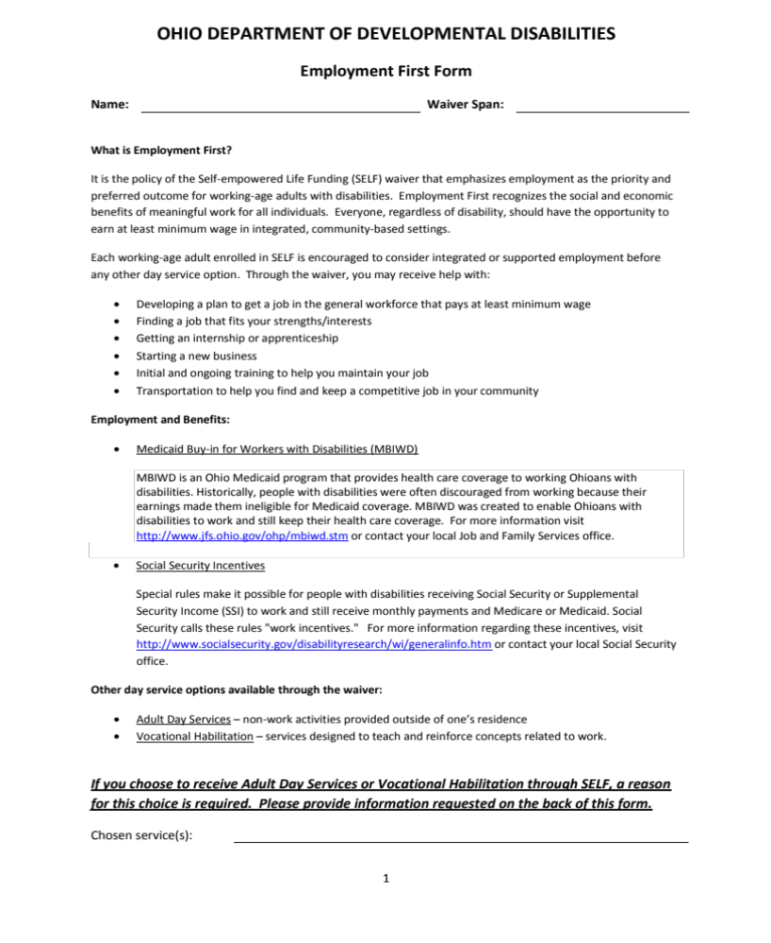
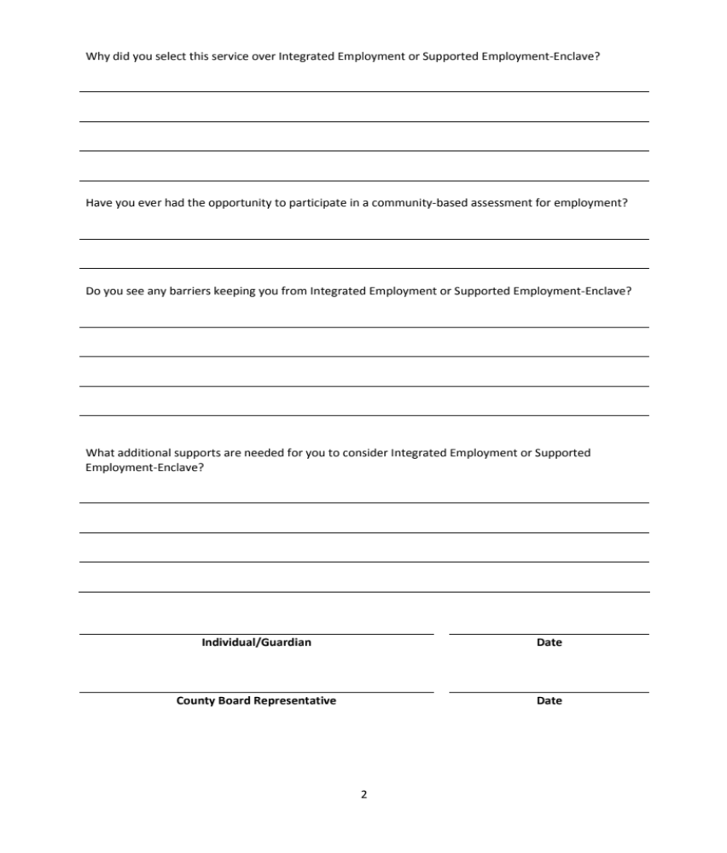
Ohio Employment First Form

Slide 38

“If you can’t
measure it,
I’m not interested.”
Laurence J. Peter

Slide 39



Making System Accountable
Data system in place that tracks outcomes: providers, system, across systems
Publicly available employment
“report card”
  System and individual provider

Slide 40


Employment First:
Contracting & Program Monitoring
Service provider contracts awarded to organizations that embrace Employment First principles
Reduced reliance on contractors that reinforce traditional service approaches
Service contracts clearly specify expectations regarding service provision and outcomes in line with Employment First principles
Standards for employment in the community are integrated within program monitoring and quality assurance processes

Slide 41


“When somebody say it’s not about the money,
it’s about the money.”
H.L. Mencken

Slide 42



The Office of Developmental Programs currently spends only 7% of service funding on integrated employment.

Slide 43


- Pay for what you want.
- Don’t pay for what you
don’t want.
Determine current breakdown of funding: community employment, facility, non-employment
Develop rate structures that provide incentives for employment
Develop funding policies that support shifting of resources to community employment & reduced funding of facility based/non-employment services

Slide 44


If you’re dealing with funding,
it means dealing with Medicaid
In most cases, vast majority of funding for services is Medicaid
CMS is pushing community employment
  E.G. – guidance on waiver definitions
New options under Deficit Reduction Act & Affordable Care Act
  E.G. 1915 (i); 1915 (k)

Slide 45



Employment First & Transition Policies
Prohibit use of facility-based services during transition
Allow facility-based services as outcome as exception requiring high administrative approval
Employment addressed as a core element of IEP starting no later than age 14
Require high level of documentation if decision is made not to pursue employment
Effective Indicator 14 measurement and monitoring

Slide 46




Employment First & Transition Practices
Presume that all students can succeed in employment
Support typical student work experiences
  Jobs after school and weekends; summer jobs
  No more job “programs”
Integrate students into school-to-career opportunities available to all students
  Internships, job shadowing, etc.
Link with vocational education programs

Slide 47




The link between disability
and poverty

Slide 48
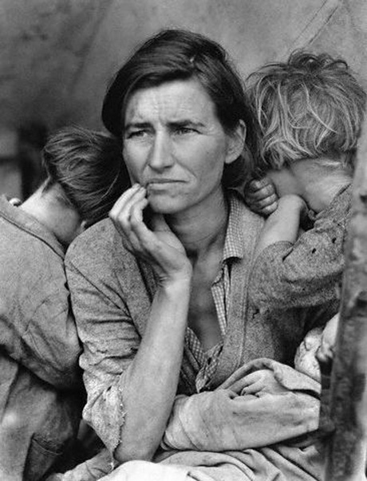
Poverty and Disability In Pennsylvania
29.6% of people with disabilities in Pennsylvania live in poverty
The poverty gap between those with and without disabilities is the sixth highest in the country –
18.5 percentage points

Slide 49


Strategies for increasing employment of people with disabilities must be interwoven with efforts to decrease poverty

Slide 50

To make Employment First a reality requires a fundamental cultural change among:
Policymakers
Service Systems & Funding Agencies
Service Providers & Staff
Employers and Businesses
People with Disabilities & Families

Slide 51
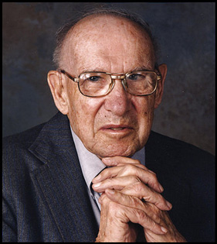
“Culture
eats strategy
for breakfast.”
Peter Drucker

Slide 52






You’re better off
not working.
Social Security told me I can’t work.
There are
no jobs.
You’re not job ready.
“I think you should go to work.”
You’ll
lose your health care!

Slide 53

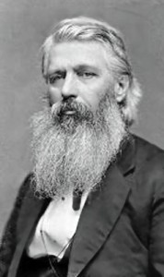
“ You can commit no greater folly than to sit by the road side until someone comes along and invites you to ride with him to wealth or influence. ”
John B. Gough

Slide 54

“Those who say it can't be done should get out of the way of those who are doing it.”

Slide 55


“ A ship in harbor is safe ---
but that is not
what ships are built for. ”
John A. Shedd

